Slide 1
Cloaking a qubit in a cavity
Sangyeon Lee
Seoul National Univ.
QDL (Quantum Device LAB. at SNU)
Prof. Eunjong Kim
Date: 2024.02.19

Slide 2
Contents
Background Knowledge : Undesired Effect of Cavity Drive
How to take a cloak? System Hamiltonian and Setting
Example 1 : Quantum Rabi
Example 2 : AC Stark Shift & Measurement Induced Dephasing
Example 3 : Arm & Release Qubit Readout Advantage
Example 4 : Fidelity of X Gate
https://github.com/BrainConnection/QuTiP

Slide 3
Background Knowledge

Slide 4
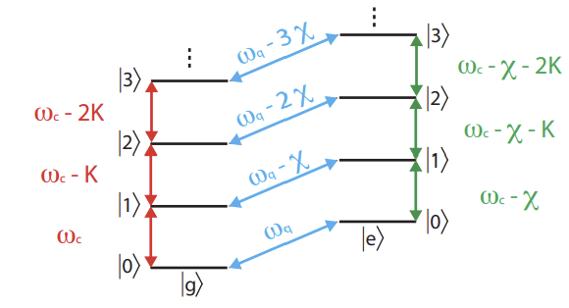
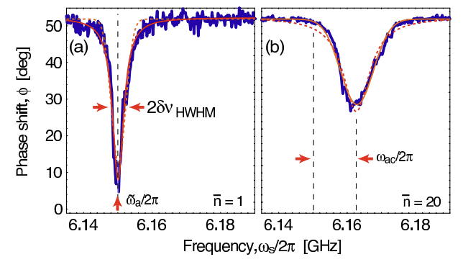
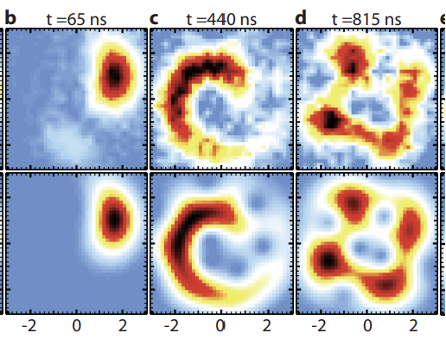
Background Knowledge
Undesired Effect of Cavity Drive
Qubit transition resulting in readout fidelity & Imperfect state Stabilization
AC Stark Shift & Measurement induced dephasing
Kerr nonlinearity

Slide 5
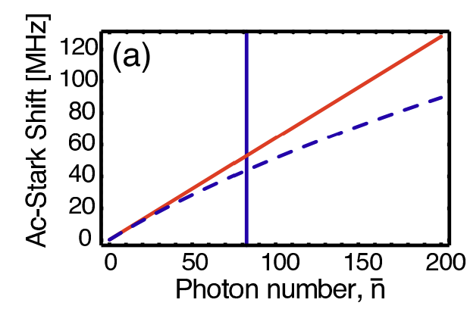
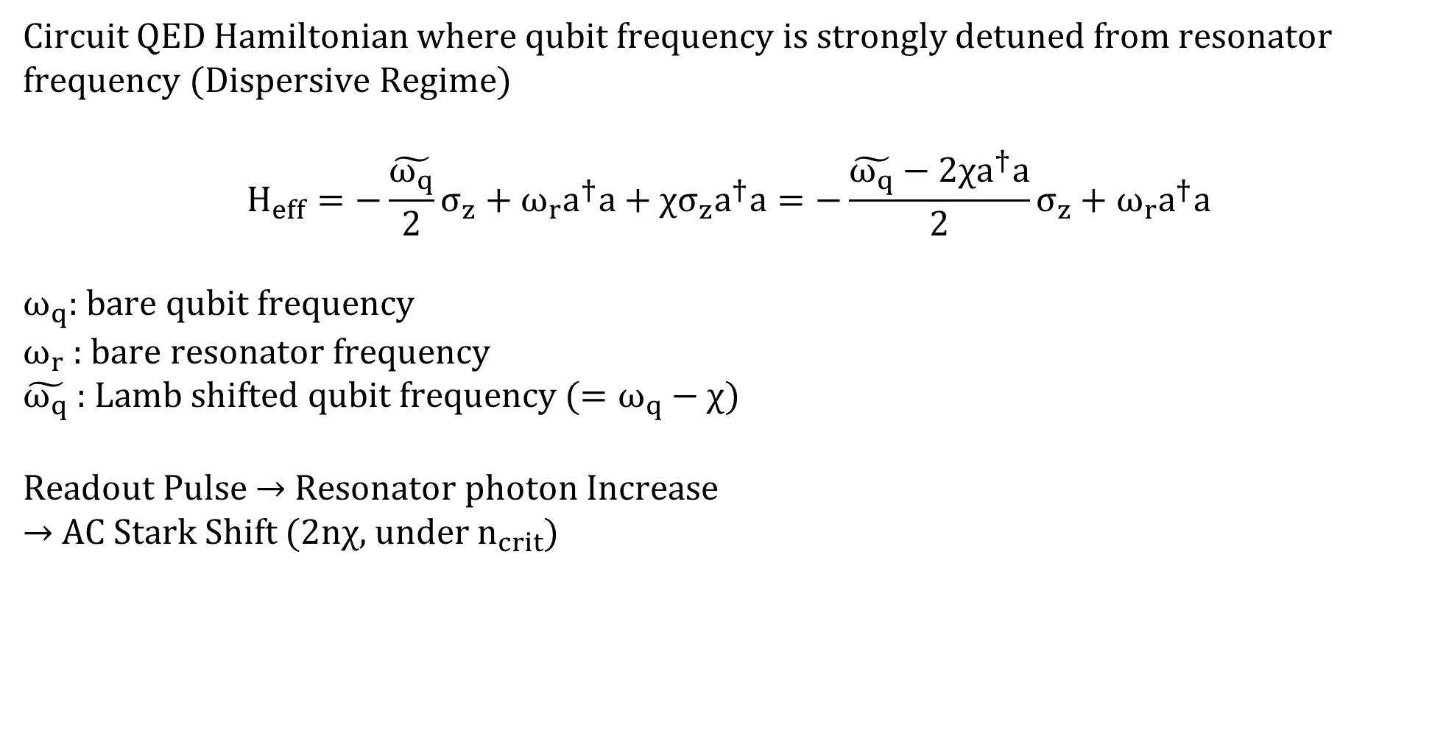
AC Stark Shift
Circuit QED Hamiltonian where qubit frequency is strongly detuned from resonator frequency (Dispersive Regime)
$$H_{eff}=−\frac{\tilde{ω_{q}}}{2}σ_{z}+ω_{r}a^{†}a+χσ_{z}a^{†}a=−\frac{\tilde{ω_{q}}−2χa^{†}a}{2}σ_{z}+ω_{r}a^{†}a$$
$ω_{q}$: bare qubit frequency
$ω_{r}$ : bare resonator frequency
$\tilde{ω_{q}}$ : Lamb shifted qubit frequency ($=ω_{q}−χ$)
Readout Pulse → Resonator photon Increase
→ AC Stark Shift ($2nχ$, under $n_{crit}$)

Slide 6
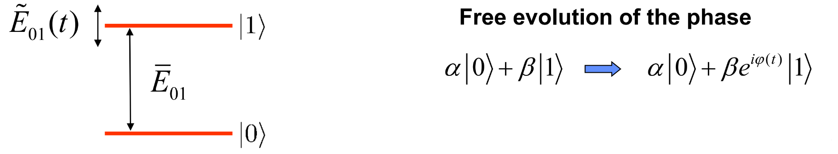

Damping
Coupling to additional uncontrolled bath → Energy relaxation and dephasing
$$\dot{ρ}=−i\left[H,ρ\right]+κD\left[a\right]ρ+γ_{1}D\left[σ_{−}\right]ρ+\frac{γ_{ϕ}}{2}D\left[σ_{z}\right]ρ$$
Dephasing & Relaxation rate not related with AC Stark Shift : $γ_{1}$, $γ_{ϕ}$
$φ\left(t\right)=\left\langle ω_{q}\right\rangle t+δφ\left(t\right)$ $\text{when}$ $δφ\left(t\right)=\int_{0}^{t}{δω_{q}\left(t^{′}\right)dt′}$

Slide 7
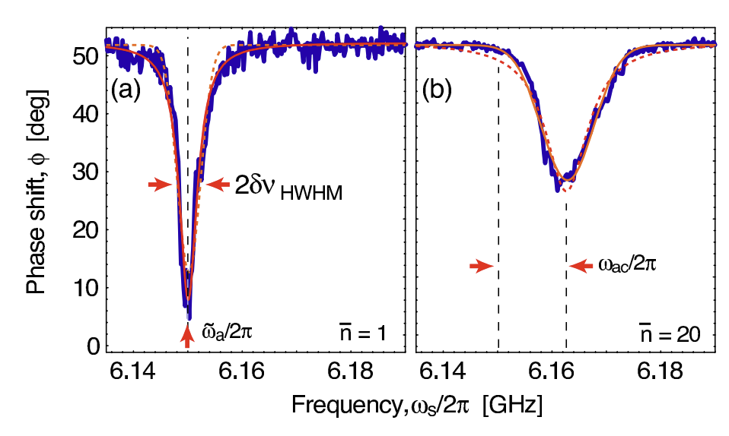

Measurement Induced Dephasing
What is main idea of “Measurement Induced Dephasing”?
“Photon Noise”
→ AC Stark Shift affect phase of qubit
→ Photon Noise Spectral Density determines dephasing!
Measured Spectroscopic lines (a) $\overline{n} ≅1$, (b) $\overline{n} ≅40$

Slide 8
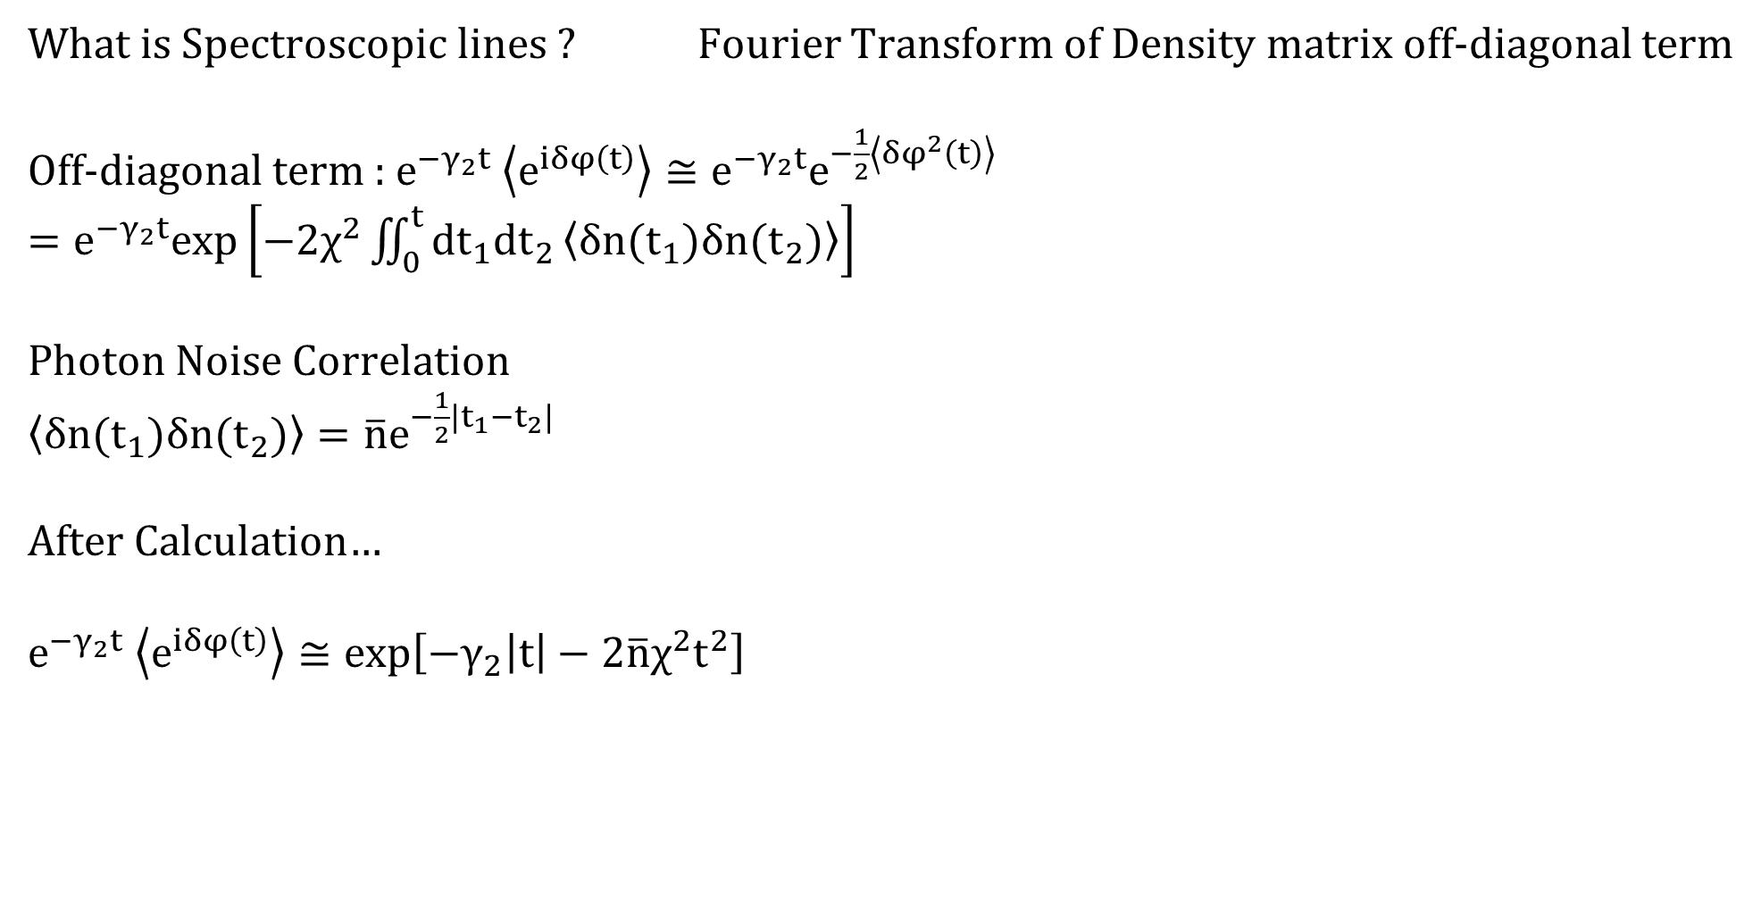
Measurement Induced Dephasing
What is Spectroscopic lines ? Fourier Transform of Density matrix off-diagonal term
Off-diagonal term : $e^{−γ_{2}t} \left\langle e^{iδφ\left(t\right)}\right\rangle ≅e^{−γ_{2}t}e^{−\frac{1}{2}\left\langle {δφ}^{2}\left(t\right)\right\rangle }$
$=e^{−γ_{2}t}exp\left[−2χ^{2}\iint_{0}^{t}{dt_{1}dt_{2}}\left\langle δn(t_{1})δn(t_{2})\right\rangle \right]$
Photon Noise Correlation
$\left\langle δn(t_{1})δn(t_{2})\right\rangle =\overline{n}e^{−\frac{1}{2}|t_{1}−t_{2}|}$
After Calculation…
$e^{−γ_{2}t} \left\langle e^{iδφ\left(t\right)}\right\rangle ≅exp\left[−γ_{2}\left|t\right|−2\overline{n}χ^{2}t^{2}\right]$

Slide 9
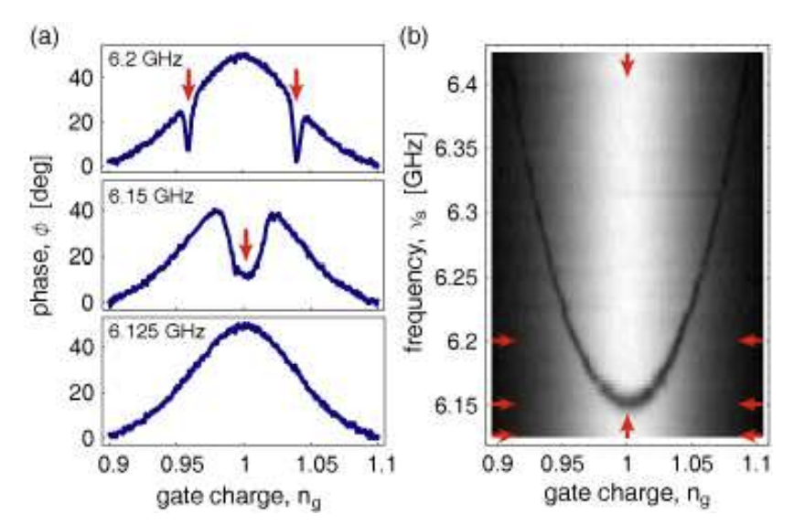

Measurement Induced Dephasing
Measured Spectroscopic lines (a) $\overline{n} ≅1$, (b) $\overline{n} ≅40$
$\overline{n}$ low : Lorentzian
$\overline{n}$ high : Gaussian
D. I. Schuster, A. Wallraff, A. Blais, L. Frunzio, R.-S. Huang, J. Majer, S. M. Girvin, and R. J. Schoelkopf,
ac Stark shift and dephasing of a superconducting qubit strongly coupled to a cavity field,
Phys. Rev. Lett. 94, 123602 (2005).

Slide 10
System Hamiltonian & Setting

Slide 11
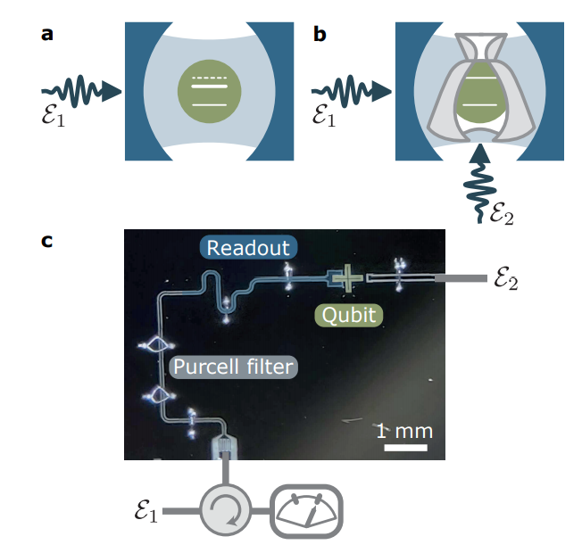
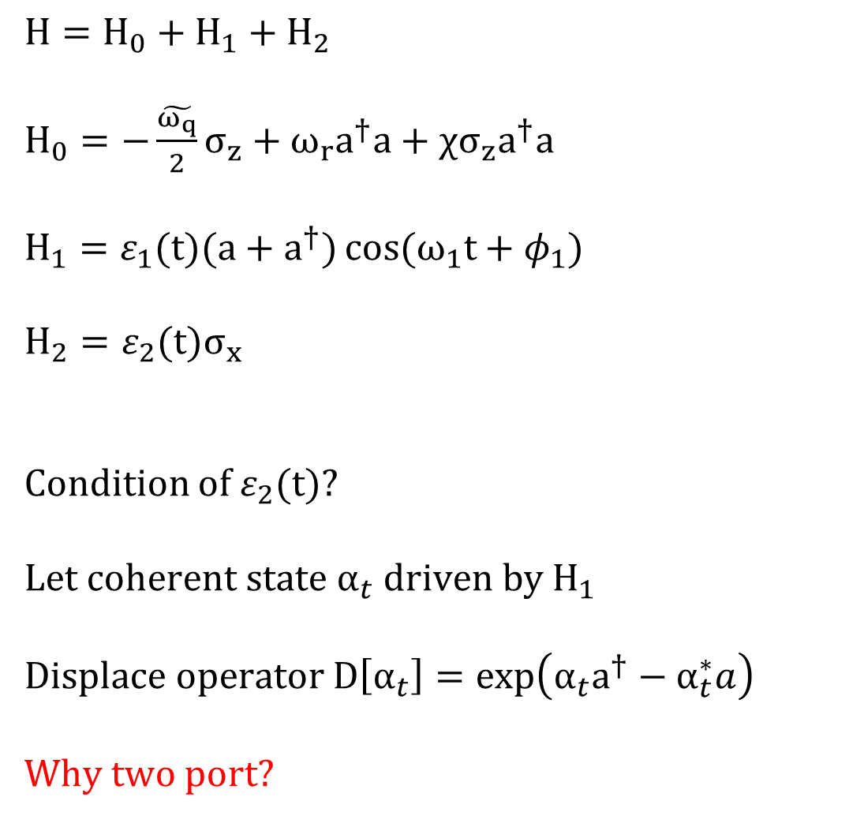
Setting
$H=H_{0}+H_{1}+H_{2}$
$H_{0}=−\frac{\tilde{ω_{q}}}{2}σ_{z}+ω_{r}a^{†}a+χσ_{z}a^{†}a$
$H_{1}=ε_{1}(t)(a+a^{†})\cos{(ω_{1}t+φ_{1})}$
$H_{2}=ε_{2}(t)σ_{x}$
Condition of $ε_{2}(t)$?
Let coherent state $α_{t}$ driven by $H_{1}$
Displace operator $D\left[α_{t}\right]=\exp\left(α_{t}a^{†}−α_{t}^{∗}a\right)$
Why two port?

Slide 12

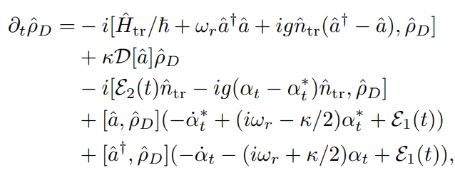
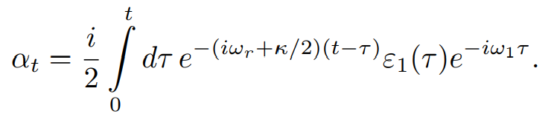

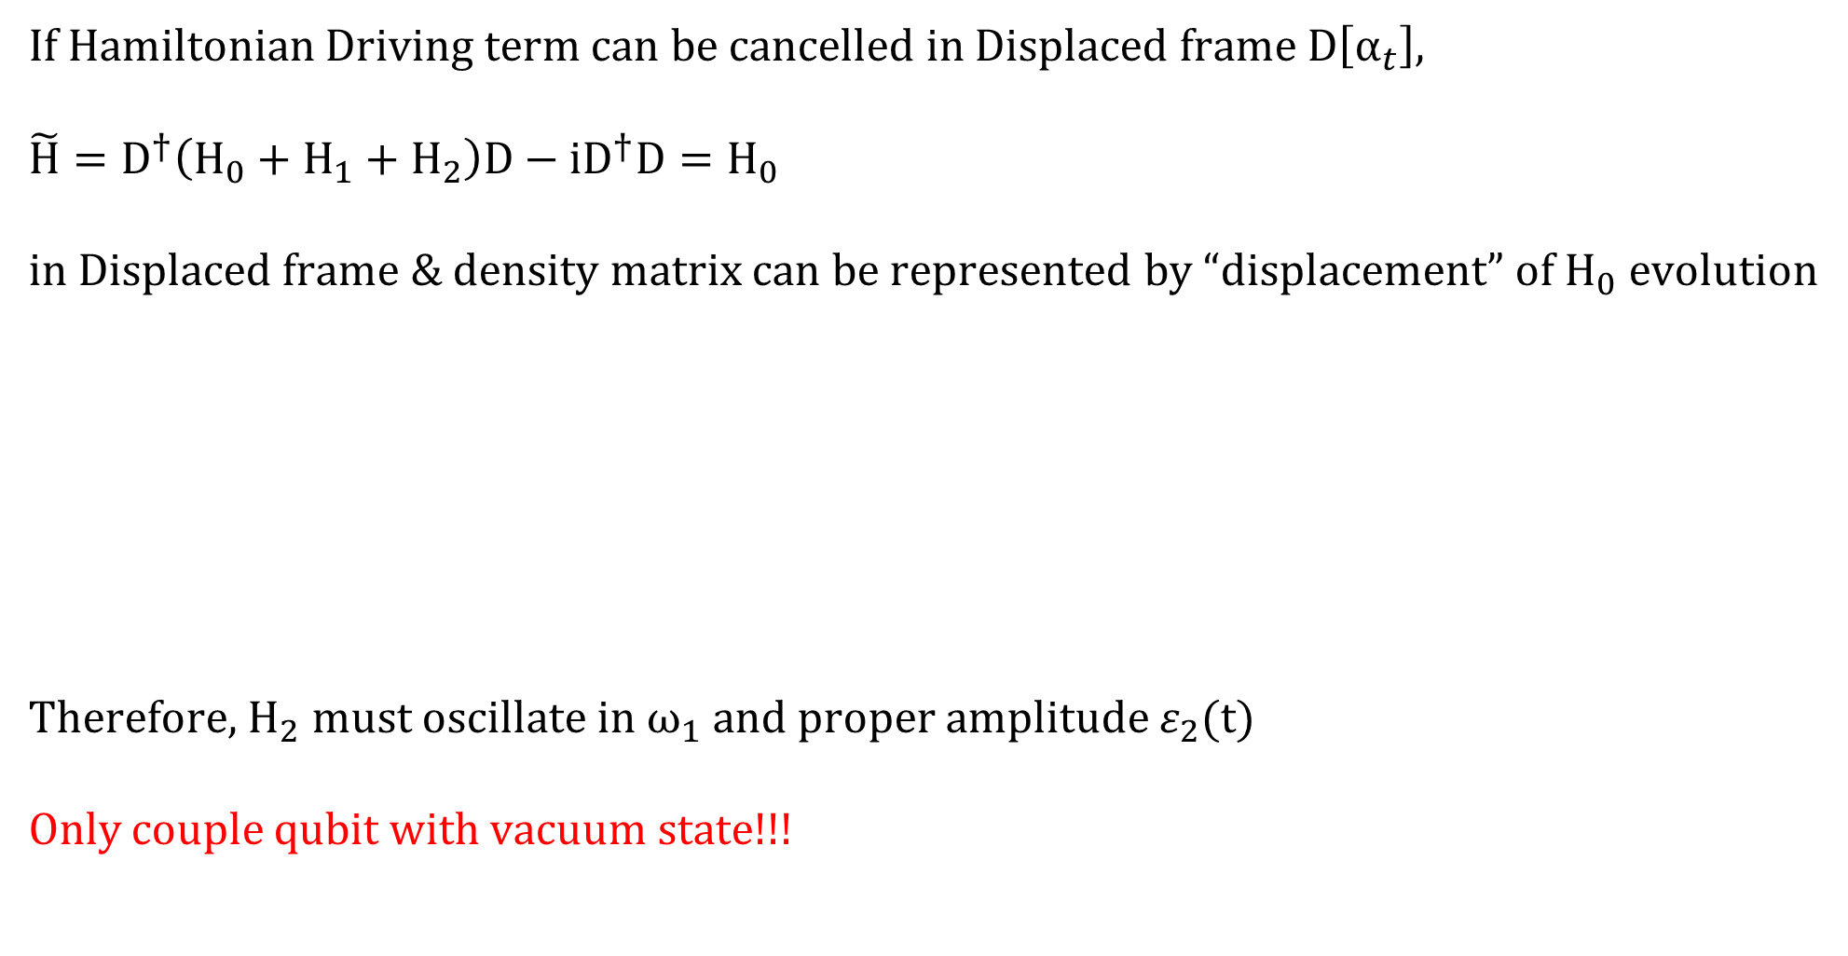
Setting
If Hamiltonian Driving term can be cancelled in Displaced frame $D\left[α_{t}\right]$,
$\tilde{H}=D^{†}\left(H_{0}+H_{1}+H_{2}\right)D−iD^{†}D=H_{0}$
in Displaced frame & density matrix can be represented by “displacement” of $H_{0}$ evolution
Therefore, $H_{2}$ must oscillate in $ω_{1}$ and proper amplitude $ε_{2}(t)$
Only couple qubit with vacuum state!!!

Slide 13
Example 1 : Quantum Rabi

Slide 14
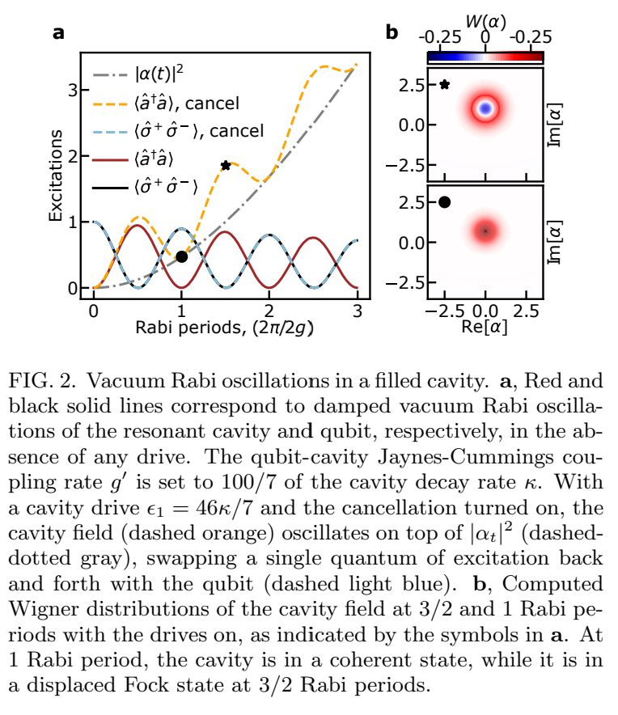
Example 1
Damping
1 state population is identical
Cancelling tone ON : 1 – photon system
Cancelling tone OFF : (N+1) – photon system
At displaced frame
1 Rabi period : Vacuum state
1.5 Rabi period : Fock state

Slide 15
Example 2 : AC Stark Shift & Measurement Induced Dephasing

Slide 16
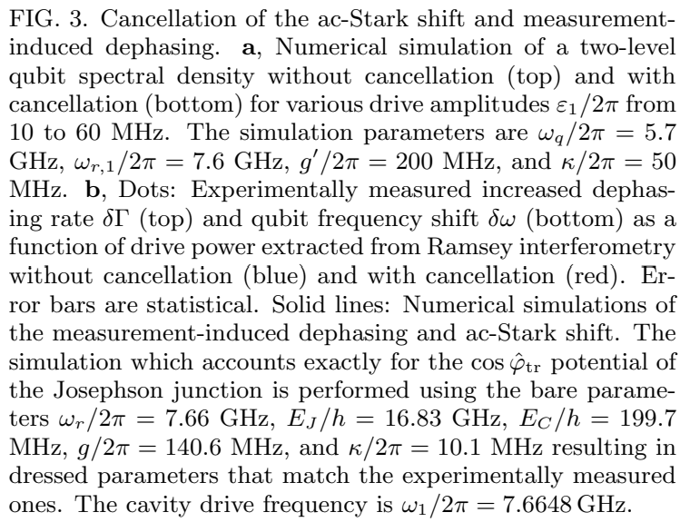
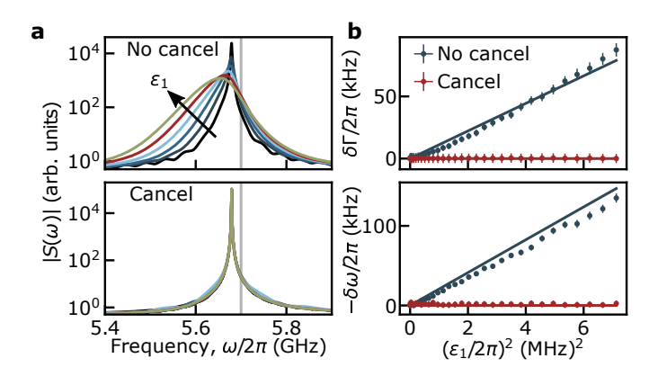

Example 2
$e^{−γ_{2}t} \left\langle e^{iδφ\left(t\right)}\right\rangle ≅exp\left[−γ_{2}\left|t\right|−2\overline{n}χ^{2}t^{2}\right]$

Slide 17
Example 3 : Arm & Release Qubit Readout Advantage

Slide 18
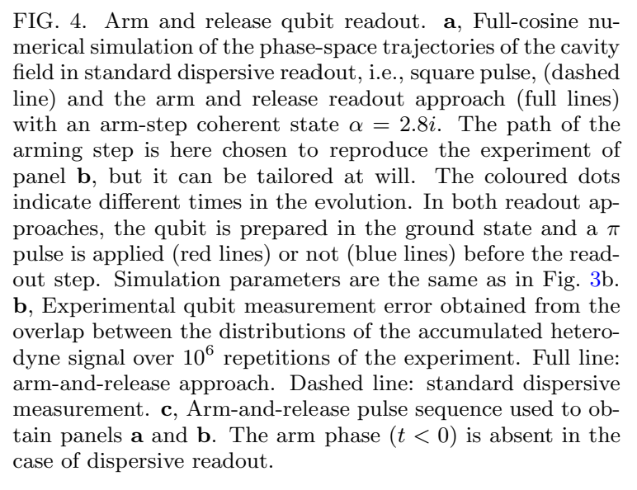
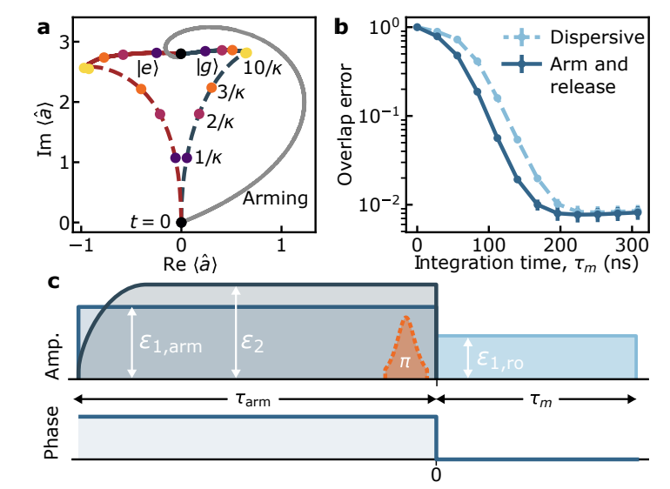
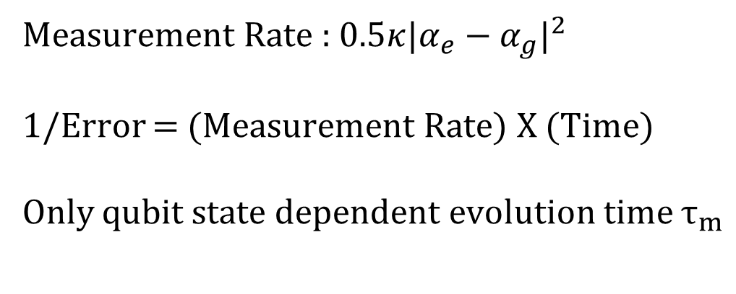
Example 3
Measurement Rate : $0.5κ{|α_{e}−α_{g}|}^{2}$
1/Error = (Measurement Rate) X (Time)
Only qubit state dependent evolution time $τ_{m}$

Slide 19
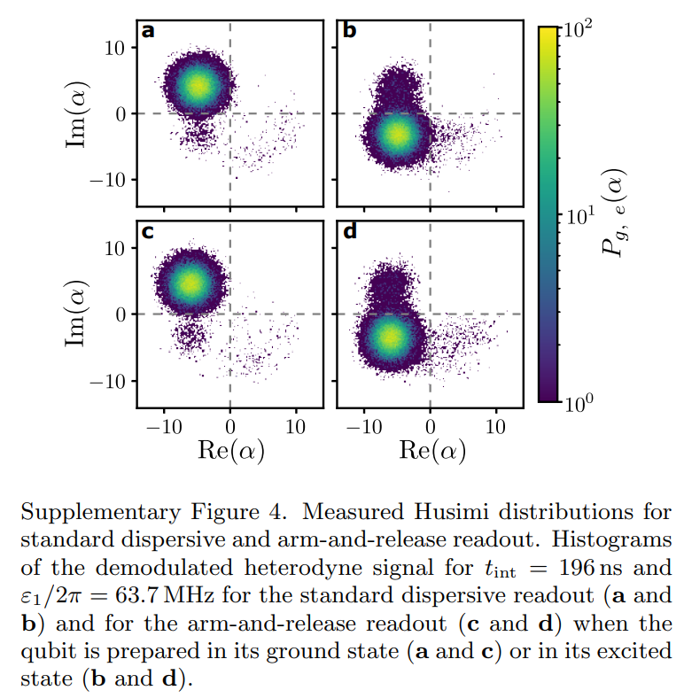
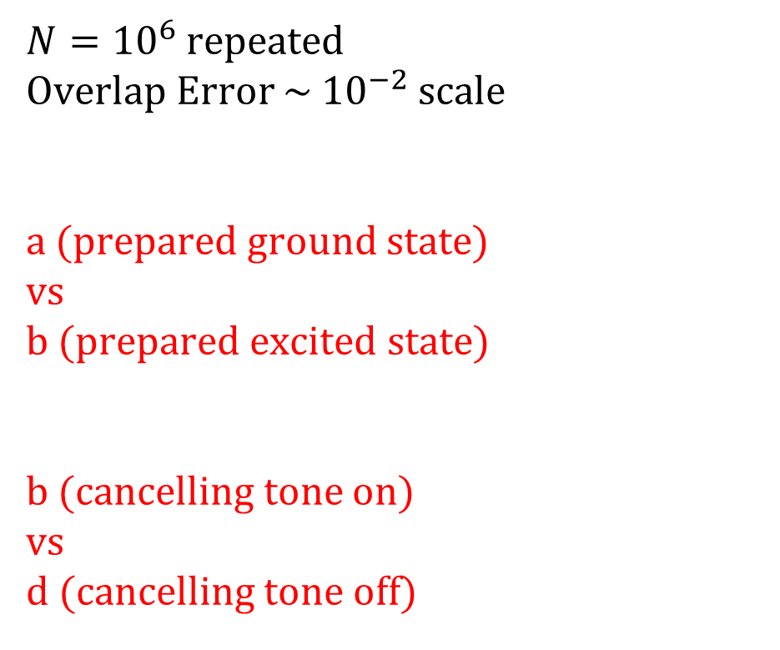
Example 3
$N={10}^{6}$ repeated
Overlap Error ~ ${10}^{−2}$ scale
a (prepared ground state)
vs
b (prepared excited state)
b (cancelling tone on)
vs
d (cancelling tone off)

Slide 20
Example 4 : Fidelity of X Gate

Slide 21
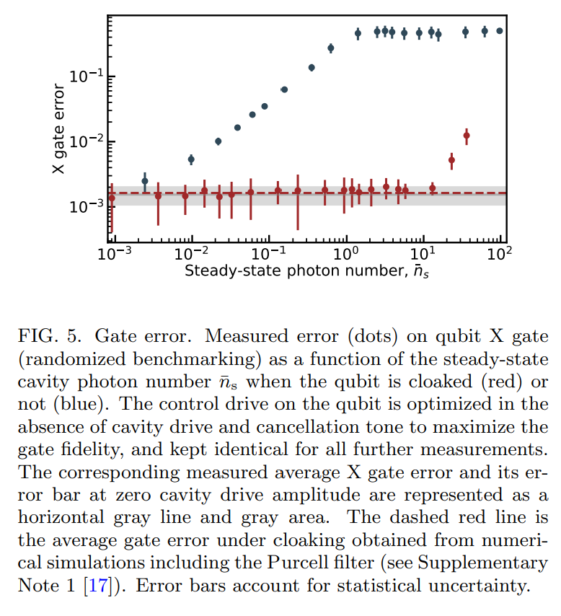
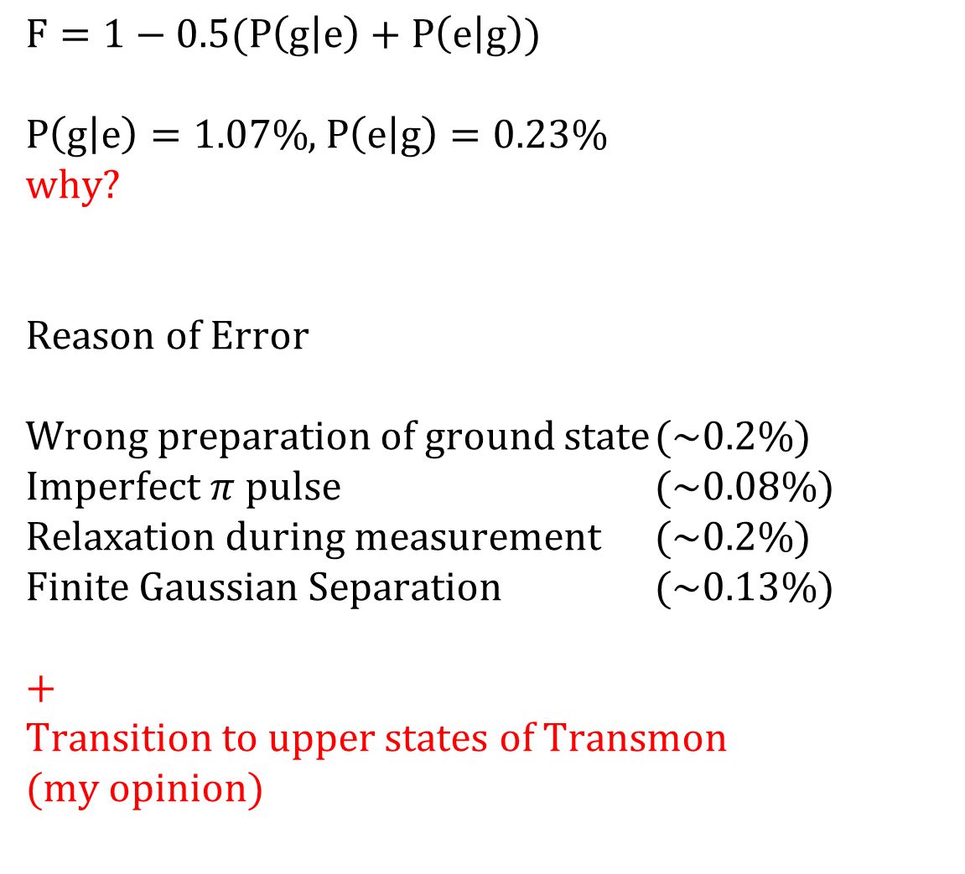
Example 4
$F=1−0.5(P\left(g | e\right)+P\left(e | g\right))$
$P\left(g | e\right)=1.07\%$, $P\left(e | g\right)=0.23\%$
why?
Reason of Error
Wrong preparation of ground state (~0.2%)
Imperfect $π$ pulse (~0.08%)
Relaxation during measurement (~0.2%)
Finite Gaussian Separation (~0.13%)
+
Transition to upper states of Transmon
(my opinion)

Slide 22
Example 4
Cancelling tone off
Photon noise induced dephasing
Cancelling tone on (more than 10 photons)
Imperfect cancelling tone calibration
(Approximation condition doesn’t hold in high photon number)

Slide 23
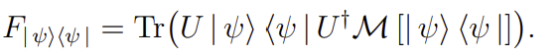


Example 4
How to measure fidelity?
Fidelity of Unitary Map when initial state is on $ψ$
Average fidelity : Average on Bloch sphere surface
It’s okay to only calculate average on $±x,±y,±z$

Slide 24
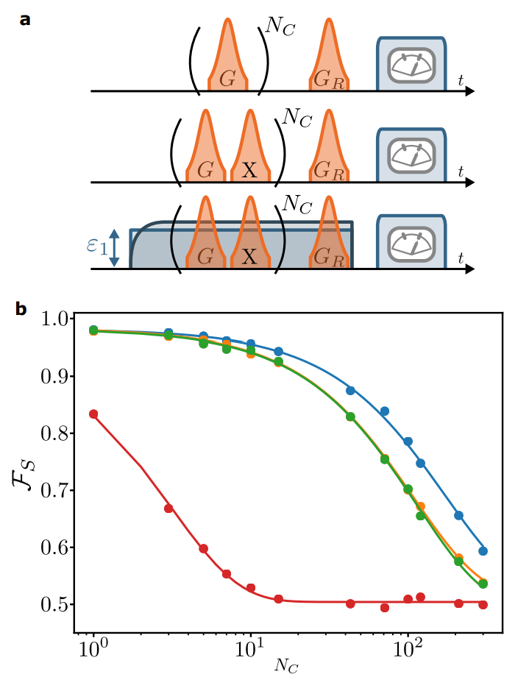
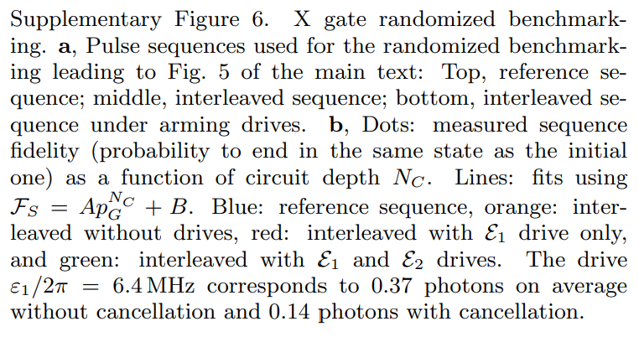

Example 4
Randomized Benchmarking
$F=Ap^{n}+B$

Slide 25
Thank you
References
[1] D. I. Schuster, A. Wallraff, A. Blais, L. Frunzio, R.-S. Huang, J. Majer, S. M. Girvin, and R. J. Schoelkopf, ac Stark shift and dephasing of a superconducting qubit strongly coupled to a cavity field, Phys. Rev. Lett. 94, 123602 (2005).
[2] G. Kirchmair, B. Vlastakis, Z. Leghtas, S. E. Nigg, H. Paik, E. Ginossar, M. Mirrahimi, L. Frunzio, S. M. Girvin, and R. J. Schoelkopf, Observation of quantum state collapse and revival due to the single-photon Kerr effect, Nature 495, 205 (2013).
[3] M. D. Bowdrey, D. K. Oi, A. J. Short, K. Banaszek, and J. A. Jones, Fidelity of single qubit maps, Phys. Lett. A 294, 258 (2002).

